Slide 1
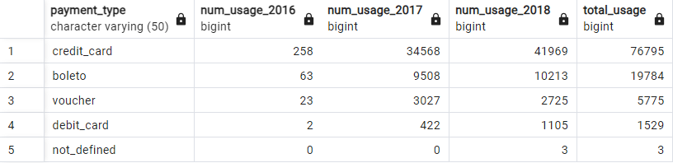
Analysis of Annual Payment Type Usage
Overview :
Effective income analysis requires consideration of the payment method and its impact on customer behavior. E-commerce businesses generally provide open-payment systems that allow customers to choose from various available payment types. Analyzing the performance of existing payment types can provide insights for creating better strategic partnerships with payment service providers. In this section, we will conduct an Annual Payment Type Usage Analysis by analyzing the total usage of each payment type.
Here is the summary table of total usage of each payment type overall and by year :
The full query can be found here

Slide 2
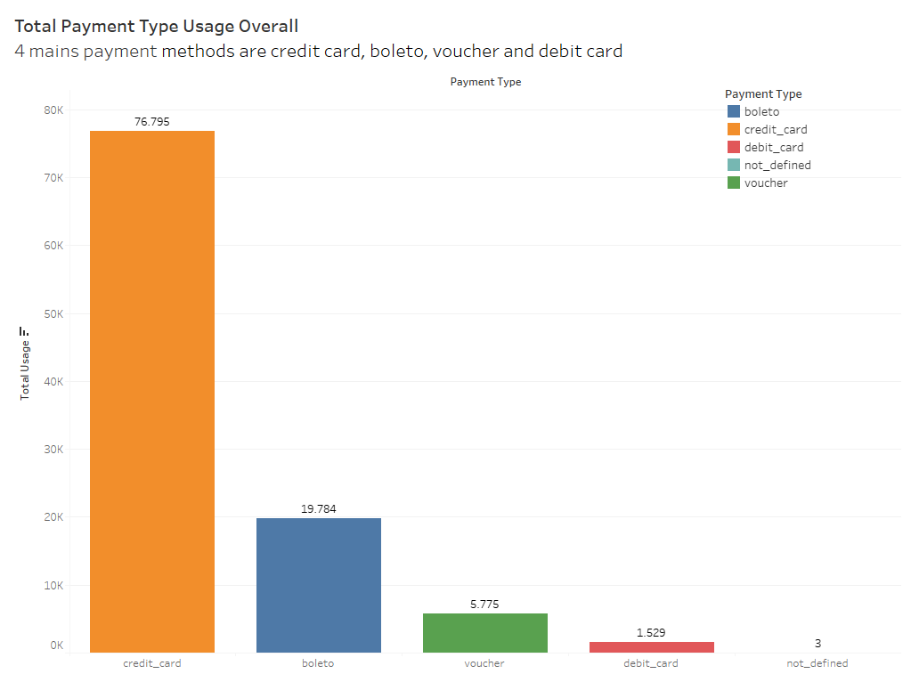
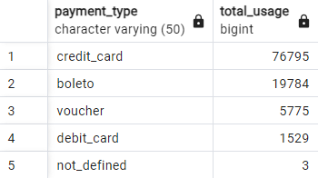
Analysis of Annual Payment Type Usage
1. Total payment type usage Overall
Displays the total usage of each type of payment at all time, sorted from the favorite
Insight :
Since credit card is the most preferred payment method, it's essential to ensure smooth and secure credit card processing. This may involve negotiating competitive transaction rates with payment processors, implementing robust fraud detection measures, and offering seamless checkout experiences for credit card users.
Other payment methods need to be enhanced in the future.

Slide 3
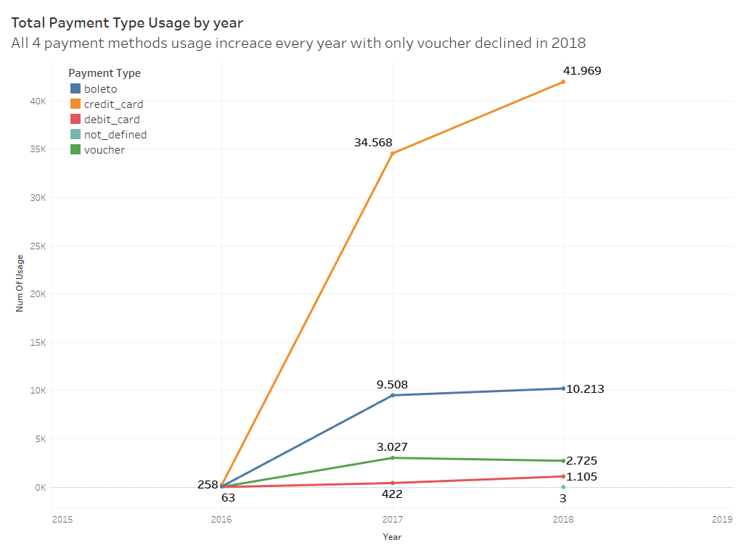
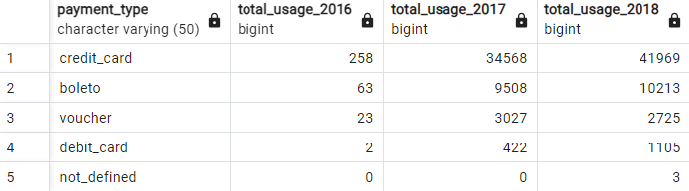
Analysis of Annual Payment Type Usage
2. Total payment type usage per year
Displays detailed information on the amount of usage for each type of payment for each year
Insight :
The consistent growth in credit card, boleto, and debit card usage suggests that customers prefer convenient and secure payment options when shopping online. This could be attributed to factors such as improved online payment infrastructure and increased trust in digital transactions.
The decline in voucher usage in 2018 may indicate a shift in consumer behavior or a specific event affecting voucher redemption. We need to analyze the factors contributing to the decline in voucher usage in 2018 and develop a targeted revitalization strategy such as refreshing promotional offers, introducing new types of vouchers, or improving the visibility of voucher redemption options during checkout.

